Slide 1

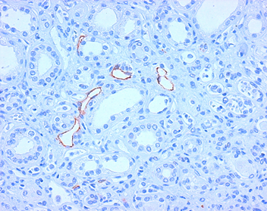
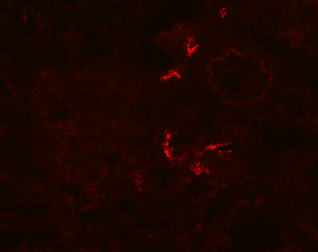
ReliaTech GmbH
Mouse anti-human Podoplanin (#4D5aE5E6)
(Cat# 101-M41)
Figure 1: Staining of lymphatic endothelial cells in normal human kidney tissue (paraffin-embedded tissue-sections fixed in formalin) with anti-human Podoplanin [Cat# 101-M41].
Figure 2: Immunofluorescence staining of lymphatic endothelial cells in normal human kidney tissue with anti-human Podoplanin [Cat# 101-M41].
http://www.reliatech.de / orders@reliatech.de

